Slide 1

Problem 4
STUCK METALLIC SPHERES
Reporter: Stanisław Rakowski Authors: Stanisław Rakowski, Kamil Dutkiewicz

Slide 2
Problem statement
Fill a bottle with small metal/plastic spheres with diameters of the same order of magnitude as the size of the opening. Try to pour the spheres out of the bottle by turning it upside down. Similar to pouring salt from small openings, one can see that after a certain time the spheres become stuck and stop pouring out.
Investigate the phenomenon.
What is the average time it takes before the system becomes stuck?
What bottle shapes can prevent the system from getting stuck?

Slide 3
Relevant parameters
Ball’s parameters
Nozzle parameters
Initial conditions
number of balls
Initial height
Opening method (velocity)
orifice diameter
Shape/angle
number of balls
Initial height
Opening method (velocity)
diameter
mass
friction/material
orifice diameter
Shape/angle
diameter
mass
friction/material
0.6 mm
v
h
0.2 g
60°

Slide 4
Relevant parameters
Fixed
Variables
mass of a ball
material of a ball
angle
number of balls
initial height
opening velocity
orifice diameter
ball’s diameter
[1] Jamming of Granular Flow in a Two-Dimensional Hopper, K. To et al, Phys. Rev. Lett. 86, 71 [2] Jamming in granular matter, A. Garcimartin et al, AIP Conference Proceedings 742, 279 (2004)

Slide 5
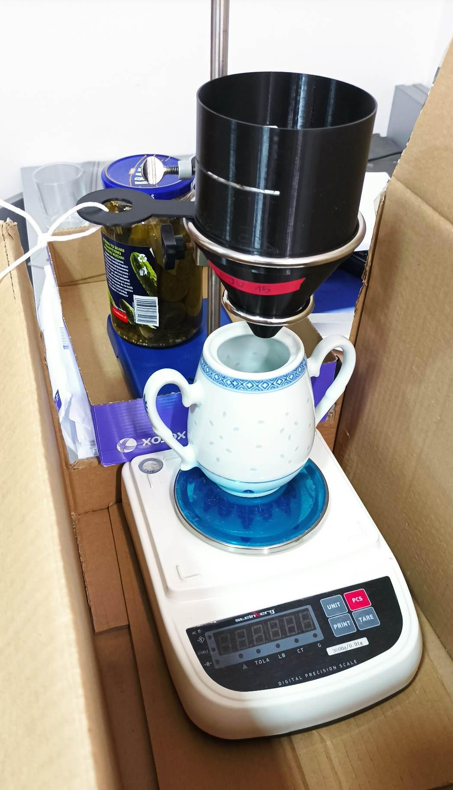
Experimental setup
0.58 mm
As fast as possible
0.2 g
60°
500 balls
cup
0 g
scale

Slide 6
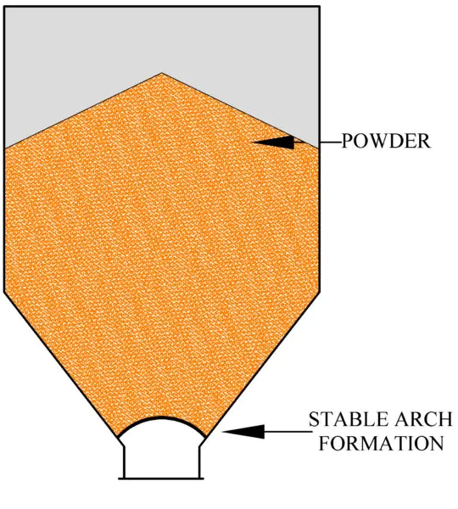
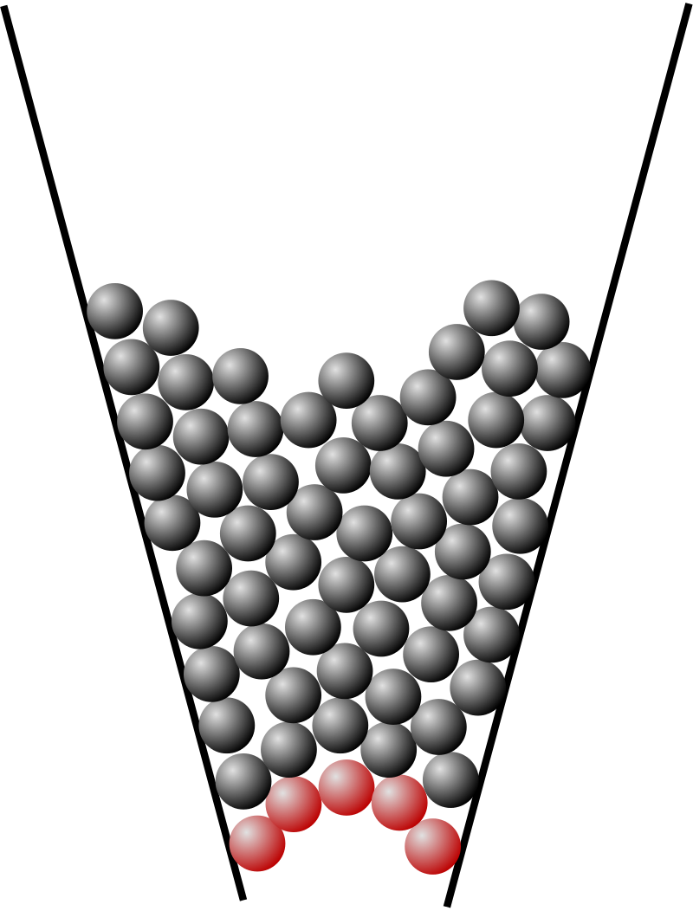
Arch formation

Slide 7

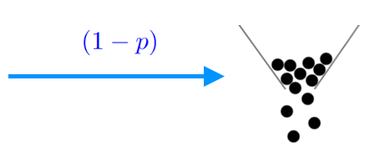
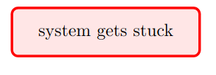
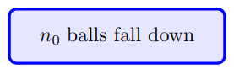
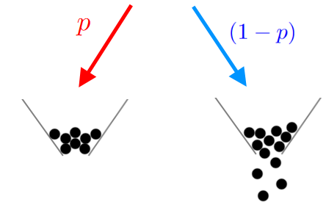
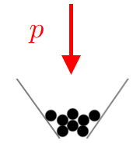
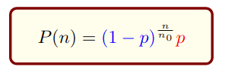
Modeling the flow as a probabilistic process

Slide 8
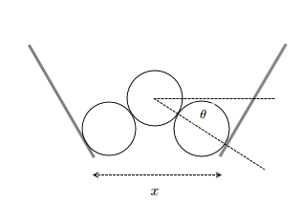
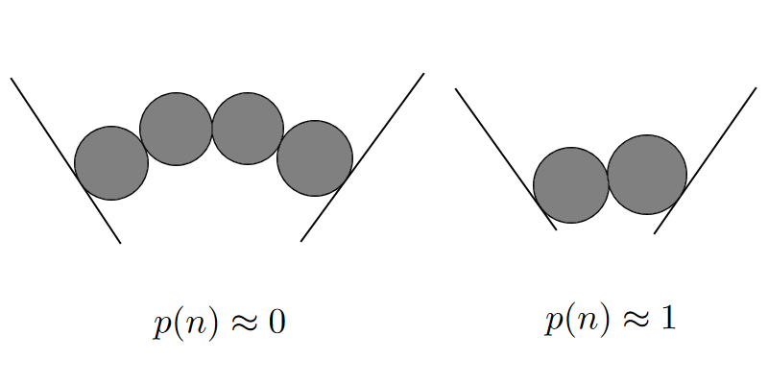
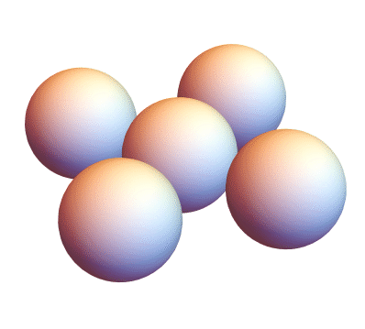
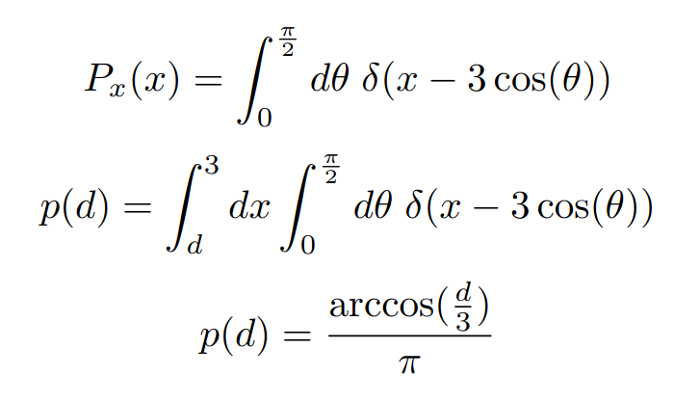
Probability of arch formation model

Slide 9
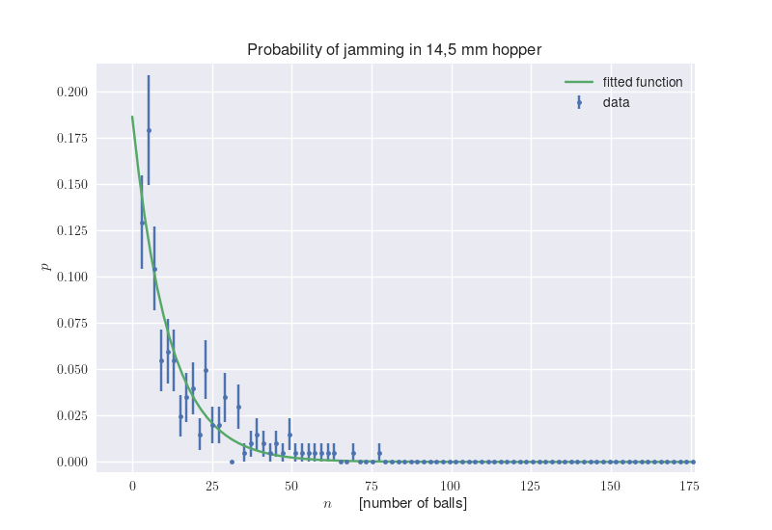
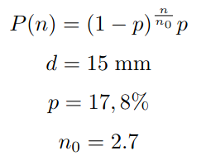
Measuring probability distribution

Slide 10
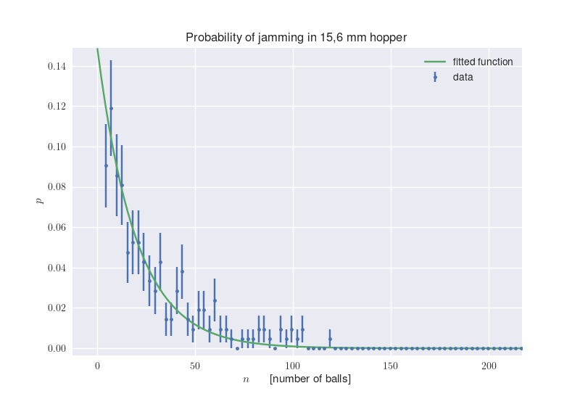
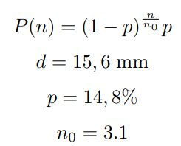
Measuring probability distribution

Slide 11
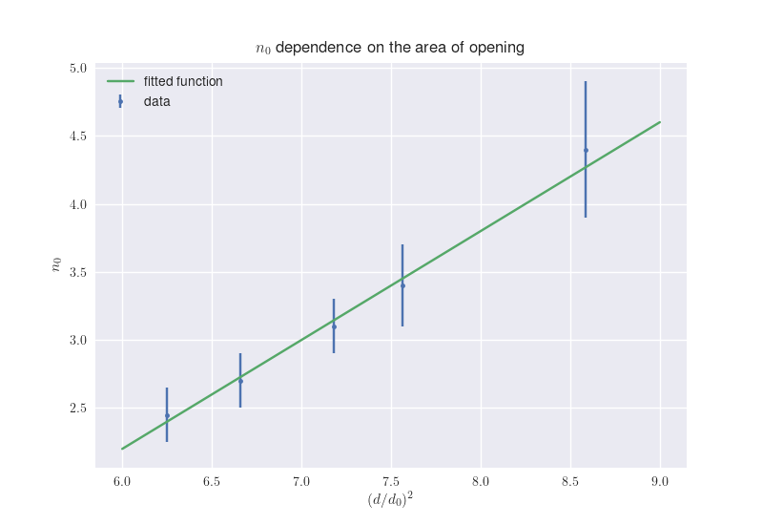
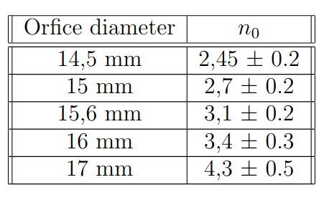
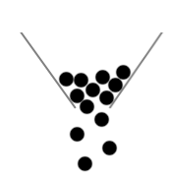
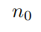
How it depends on the diameter of the orifice
$$n_{0}\left(d\right)=ad^{2}+b$$

Slide 12
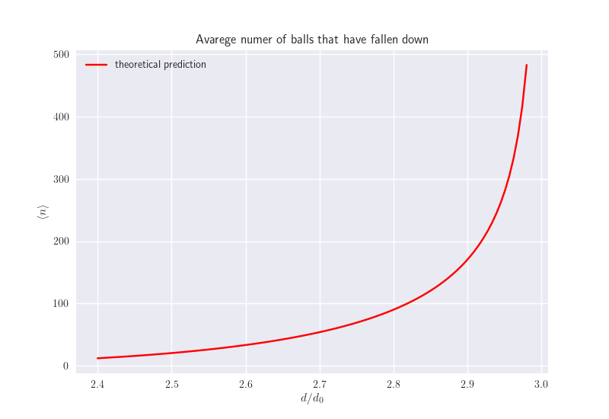
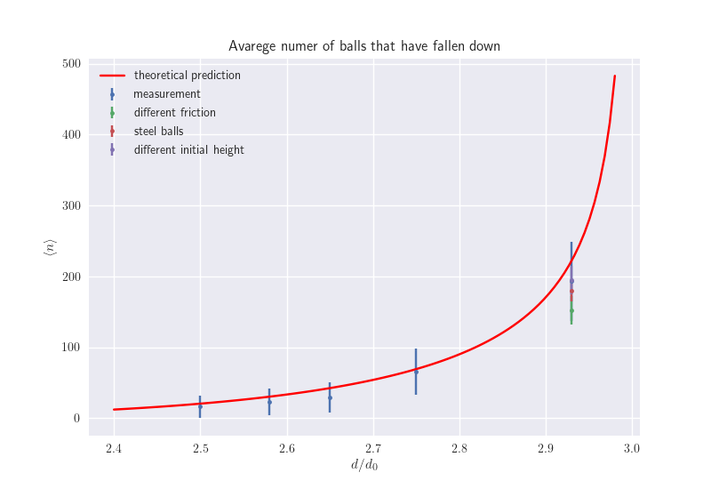
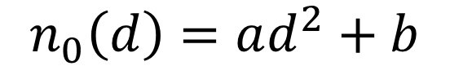
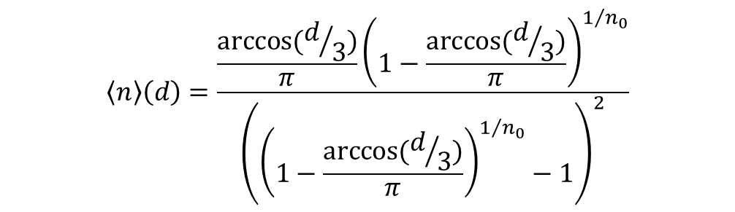
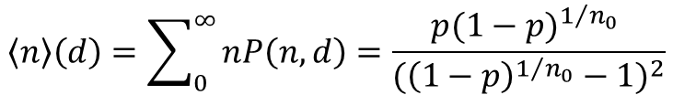
Calculating expected number of balls
$$\left\langle n\right\rangle \left(d\right)=\sum_{0}^{∞}{nP\left(n,d\right)=\frac{{p(1−p)}^{1/{n_{0}}} }{{({\left(1−p\right)}^{1/{n_{0}}}−1)}^{2}}}$$
$$\left\langle n\right\rangle \left(d\right)=\frac{\frac{arccos⁡(d/3)}{π}{\left(1−\frac{arccos⁡(d/3)}{π}\right)}^{1/{n_{0}}}}{{\left({\left(1−\frac{arccos⁡(d/3)}{π}\right)}^{1/{n_{0}}}−1\right)}^{2}}$$
$$n_{0}\left(d\right)=ad^{2}+b$$

Slide 13
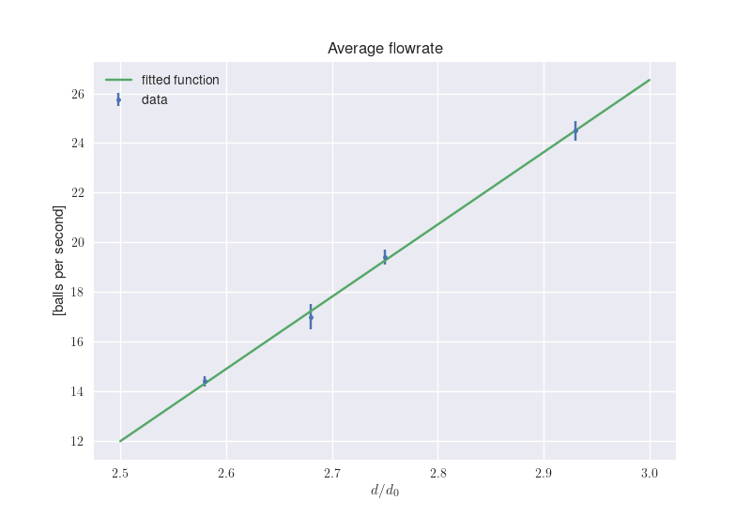
Measuring time

Slide 14
Final solution to nº 2

Slide 15

Designing the optimal nozzle
3. What bottle shapes can prevent the system from getting stuck?
L = 10 cm
Optimization problem:
Given a cylinder of diameter L and balls of radius r, find the shortest (in terms of h) nozzle, that has an orifice of diameter d and never or almost never gets stuck.
For simplicity, we limit our solutions to cylindrically symmetrical ones.
h
d

Slide 16
Sequence of nozzles

Slide 17
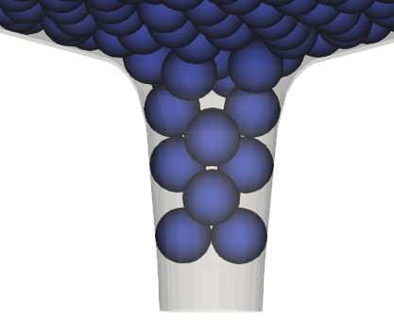
Polishing our nozzle
Simulation
LIGGGHTS – open source discrete element method particle simulation software
https://www.engineerdo.com/2019/10/04/liggghts/
After 16 iterations…

Slide 18
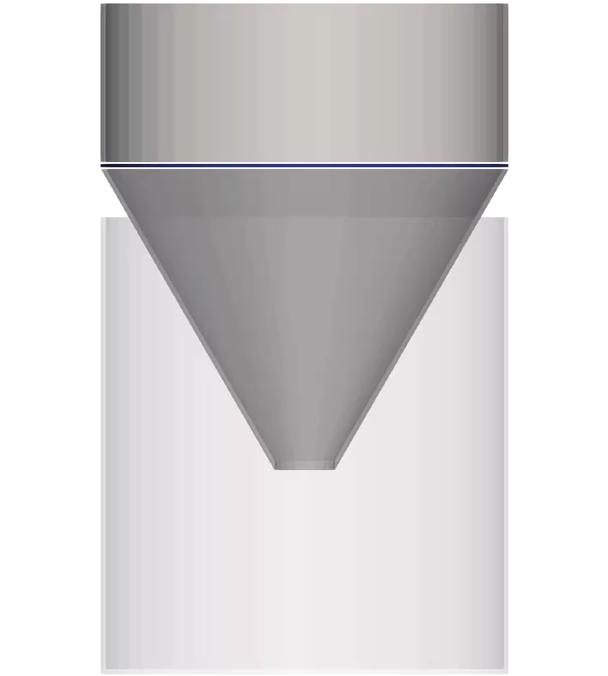
Simulation

Slide 19
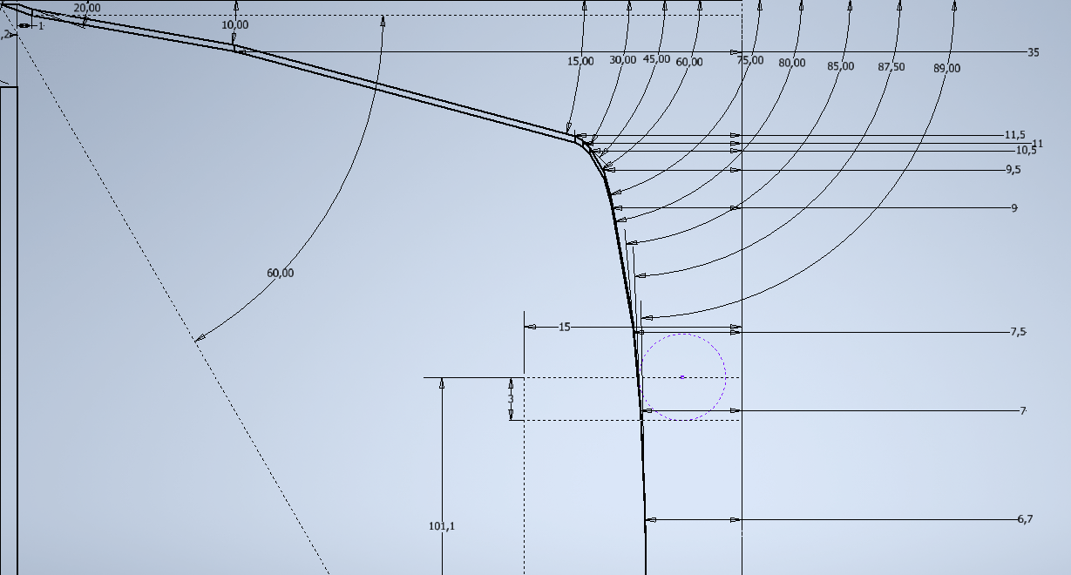
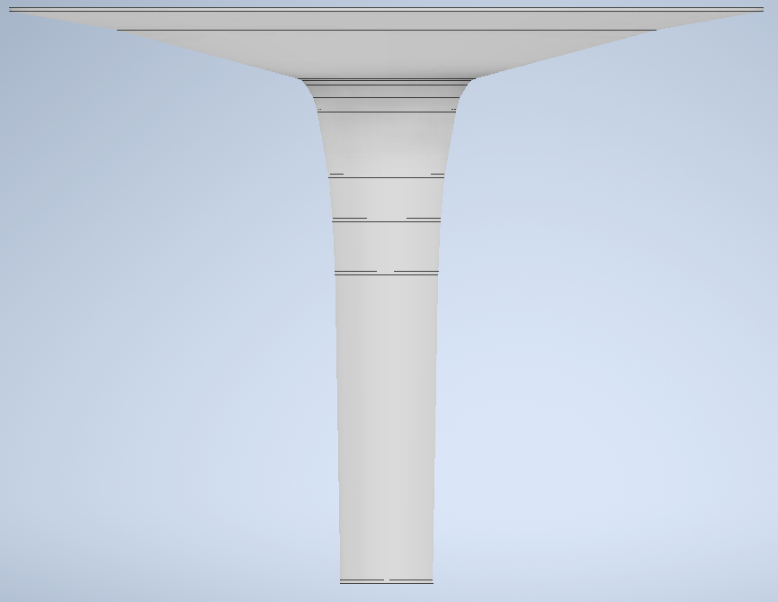
Polishing our nozzle

Slide 20
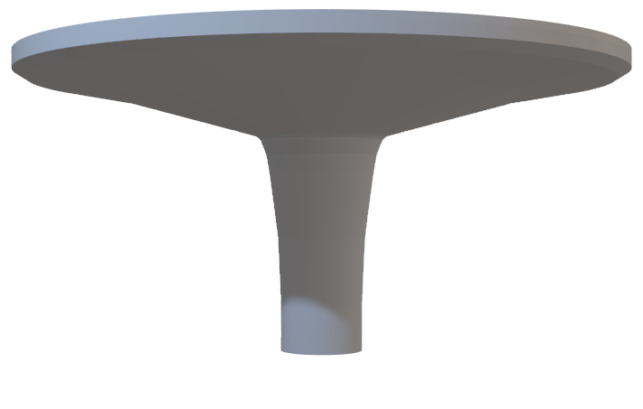
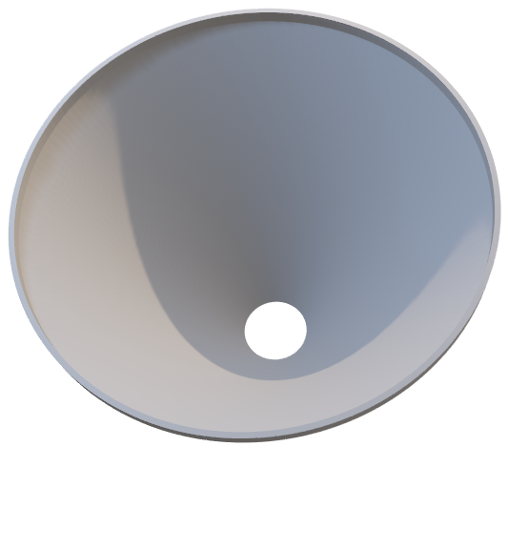
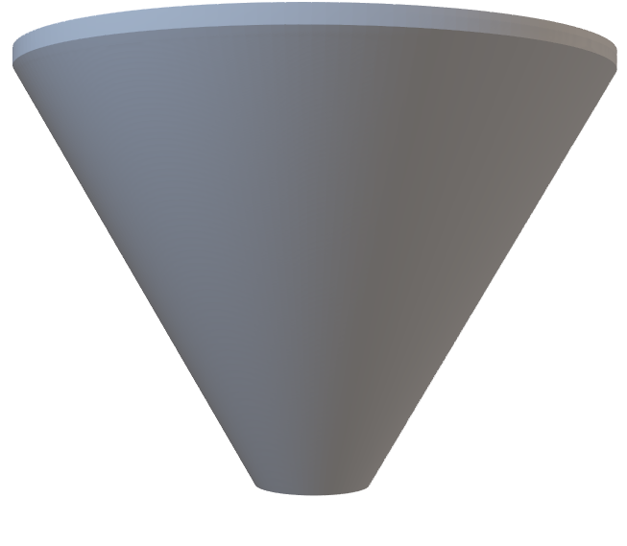
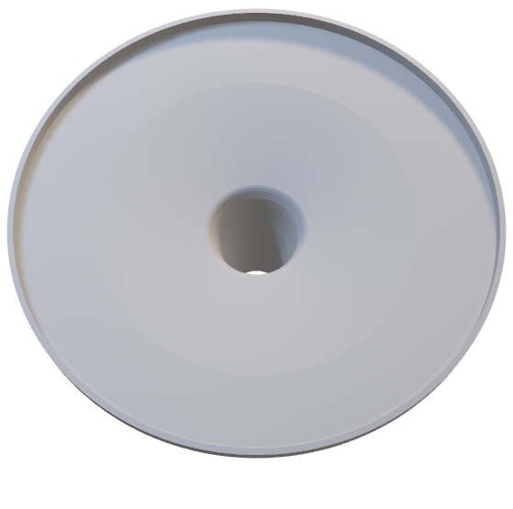
Optimal nozzle comparison
100% stuck
5,5% stuck

Slide 21
Summary
We stated that spheres in a bottle get stuck because of arch formation
We developed a theory that explained the distribution of the results and the mechanism behind the phenomenon
We calculated how much time it take for a system to get stuck
We designed the shape of a nozzle that prevents the system from jamming in 94.5 % of cases

Slide 22
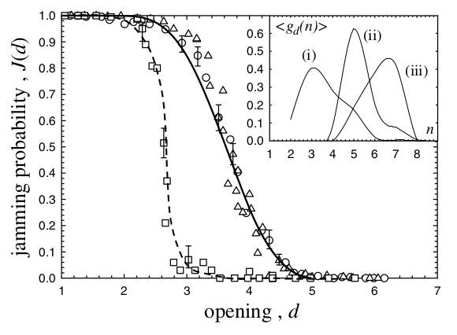
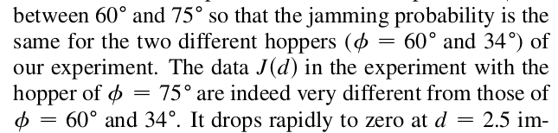
Angle dependence
[1]Jamming of Granular Flow in a Two-Dimensional Hopper, K. To et al, Phys. Rev. Lett. 86, 71 [2]Jamming in granular matter, A. Garcimartin et al, AIP Conference Proceedings 742, 279 (2004)

Slide 23
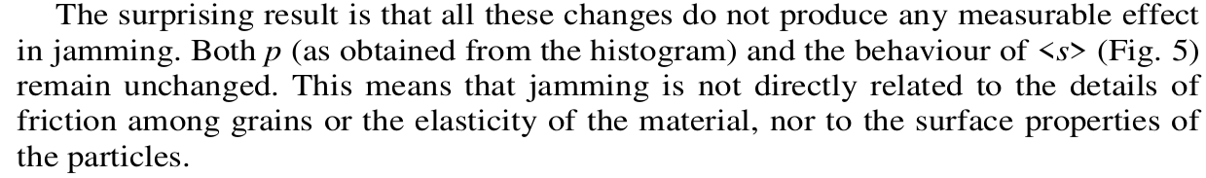
Friction dependence
[1]Jamming of Granular Flow in a Two-Dimensional Hopper, K. To et al, Phys. Rev. Lett. 86, 71 [2]Jamming in granular matter, A. Garcimartin et al, AIP Conference Proceedings 742, 279 (2004)

Slide 24
Initial conditions dependence

Slide 25
Finding the optimal nozzle
desired d
2 diameters of the ball

Slide 26
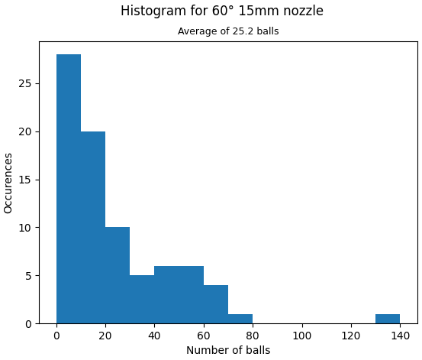
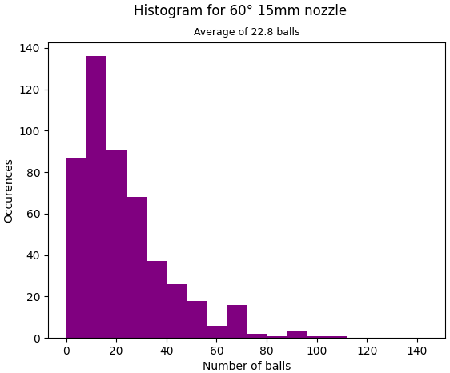
Base experimental and simulated results

Slide 27
But
This is why flat nozzles require more balls to get stuck

